Slide 1
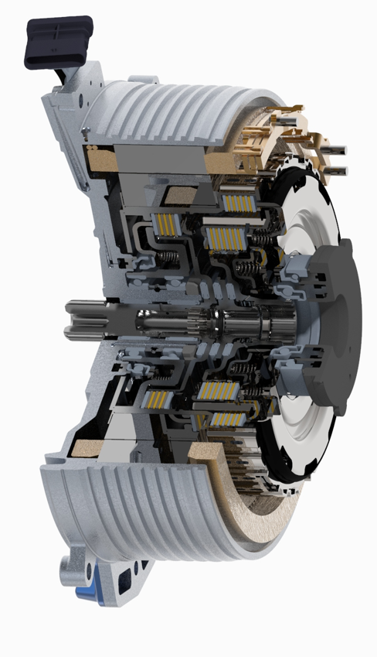
PITEF Project – Electric machine key characteristics
KEY CHARACTERISTICS | SPECIFICATION
Motor type | PMSM
Winding technology | Concentrated
Rated torque | 175 Nm
Rated power | 50 kW
Knee speed (nominal curve) | 2750 rpm
Peak torque | 330 Nm
Peak power | 85 kW
Knee speed (peak curve) | 2450 rpm
Max speed | 6000 rpm
Max efficiency | 95.6 %
Stator outer diameter | 275 mm
Active length | 56 mm
Overall length | 94 mm

Slide 2
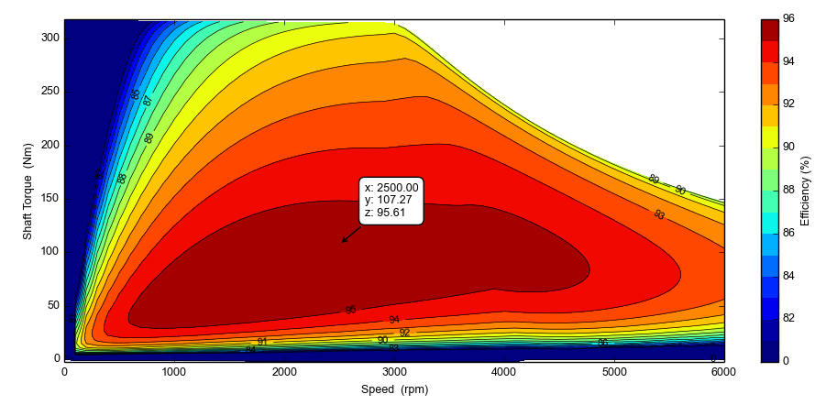
PITEF Project – Electric machine key characteristics
Efficiency map @ 120 °C stator temp.
KEY CHARACTERISTICS | SPECIFICATION
Peak efficiency | 95.6%
> 90% efficiency | > 73% of the map
> 85% efficiency | > 85% of the map
> 80% efficiency | > 90% of the map

Slide 3
APPENDIX

Slide 4
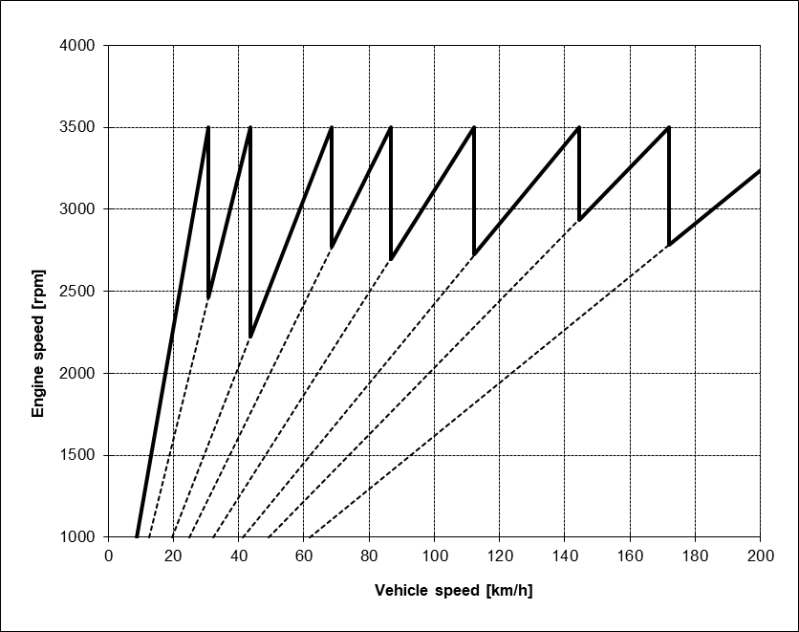
PITEF Project – IVECO Daily key characteristics (baseline)
ZF AT8 TRANSMISSION |  | VALUES
Gear | Gear ratio | V1000 [km/h]
1 | 4.714 | 8.8
2 | 3.314 | 12.4
3 | 2.106 | 19.6
4 | 1.667 | 24.7
5 | 1.285 | 32.1
6 | 1.000 | 41.2
7 | 0.839 | 49.2
8 | 0.667 | 61.8
FDR | 3.300
tyres | 225/75R16 (Rr= 0.361 m)
COAST DOWN VALUES | VALUES
Vehicle mass | 3283 kg
F0 | 345 N
F1 | 0
F2 | 0.1007 N/km/h²
P @ 100 km/h | 37.6 kW

Slide 5
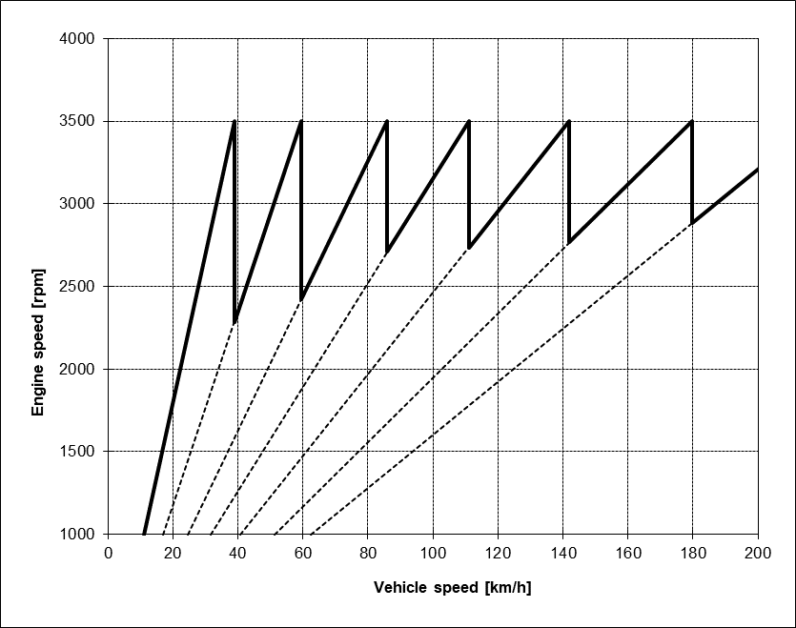
PITEF Project – IVECO Daily Proto
Preliminary transmission proposal (TBC)
TREMEC TR9070 TRANSMISSION |  | VALUES
Gear | Gear ratio | V1000 [km/h]
1 | 3.140 | 11.1
2 | 2.050 | 17.0
3 | 1.420 | 24.6
4 | 1.100 | 31.7
5 | 0.860 | 40.6
6 | 0.680 | 51.3
7 | 0.560 | 62.3
FDR | 3.900
tyres | 225/75R16 (Rr= 0.361 m)
Final Drive Ratio can be optimized taking into consideration VDE (Vehicle Demand Energy) for the reference driving cycles and the torque support coming from the Electric Machine (gradeability to be evaluated)

